Slide 1


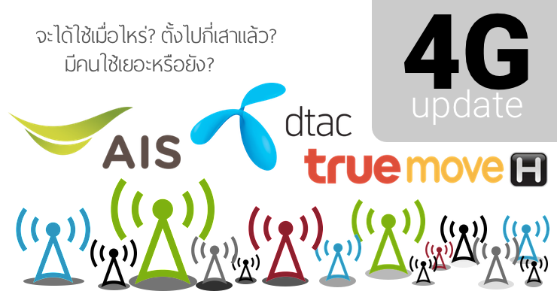
KPI June 2023 Monthly Report R1_LN
01 - 30 Jun 2023 @Managed Service (Chiang Mai)
Event Over all = 6516 Ticket +900/1800 = 1085 TT
+2600 = 183 TT
+700 = 88 TT
Present by : Santisuk Suthanma
Date : 19 Jul 2023
Managed Service

Slide 2
Agenda KPI Monthly Jun 2023
1. KPI Performance
2. Trend Main Power failure
3. Repeat Fault
4. Cause of fault
5. Over SLA
6. Fault Fiber Optic
Managed Service

Slide 3
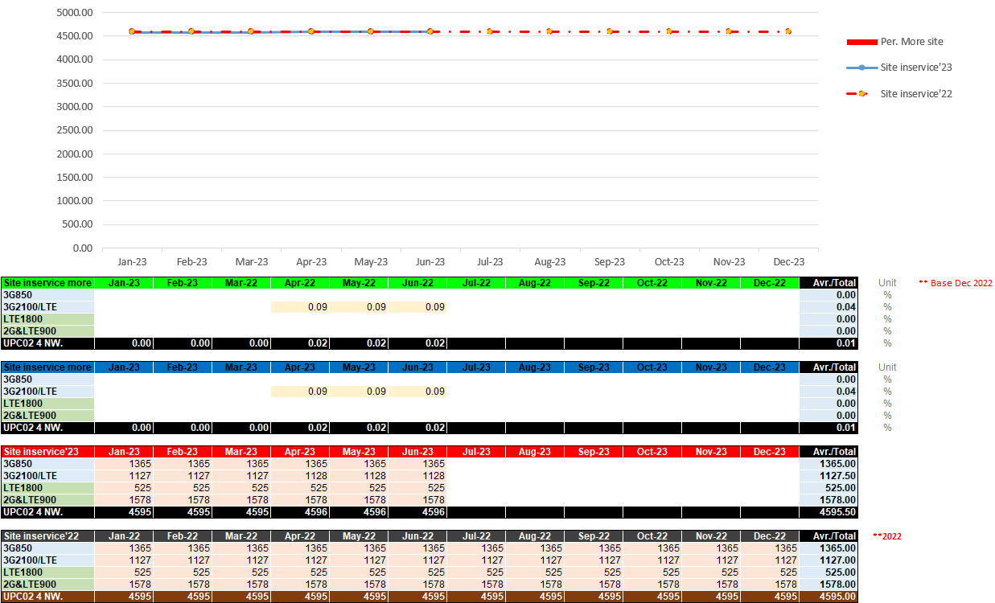
Site in-services
Managed Service

Slide 4
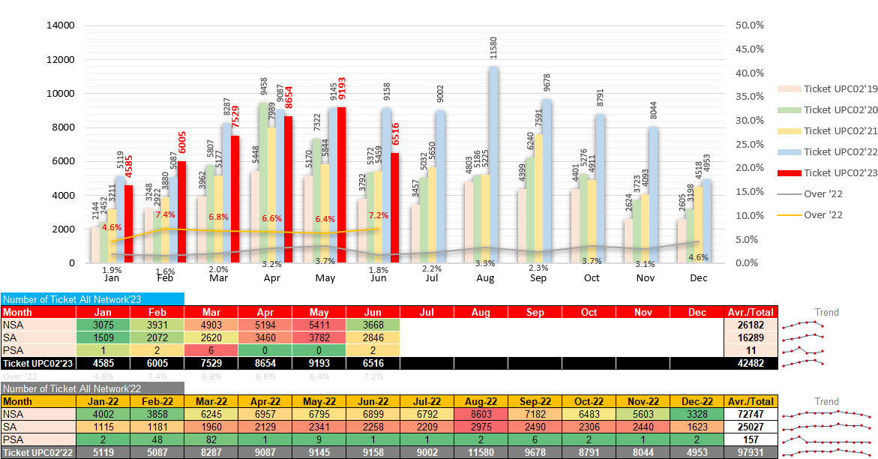
Compare Ticket 2022 vs. 2023
Managed Service

Slide 5
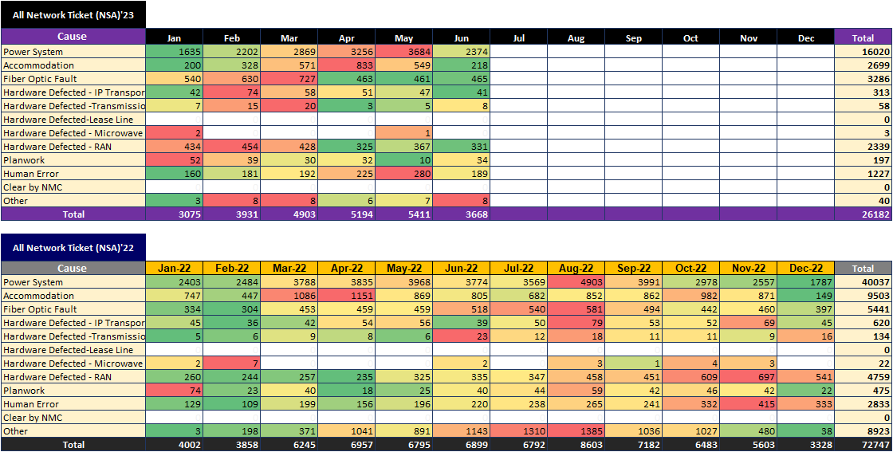
Compare Ticket 2022 vs. 2023
Managed Service

Slide 6
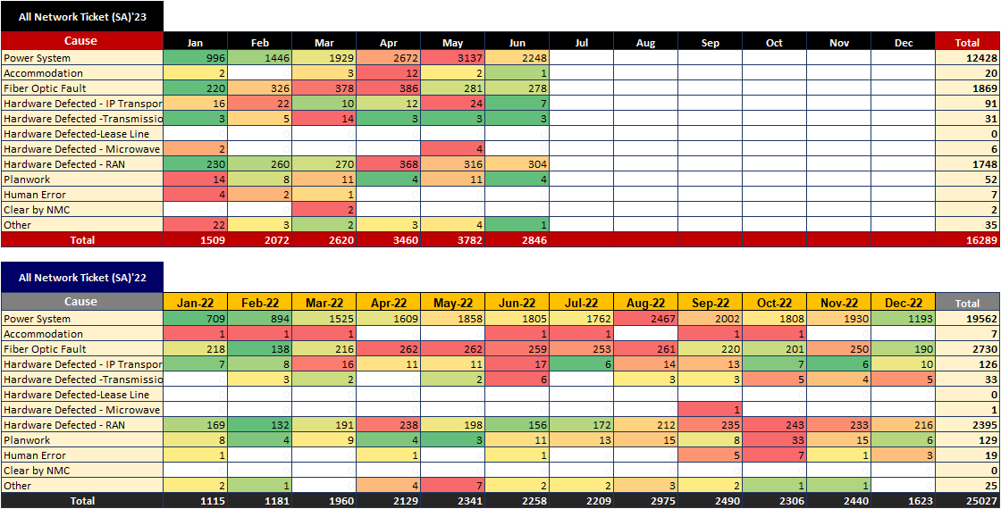
Compare Ticket 2022 vs. 2023
Managed Service

Slide 7
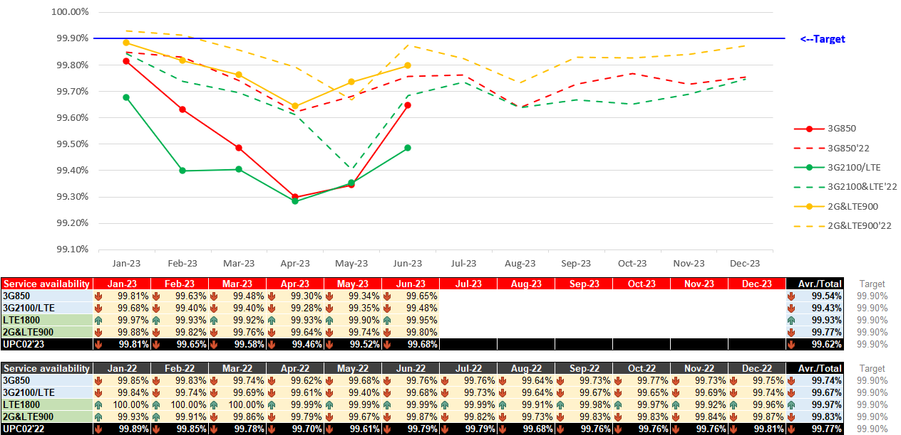
All Service availability compare
Managed Service

Slide 8
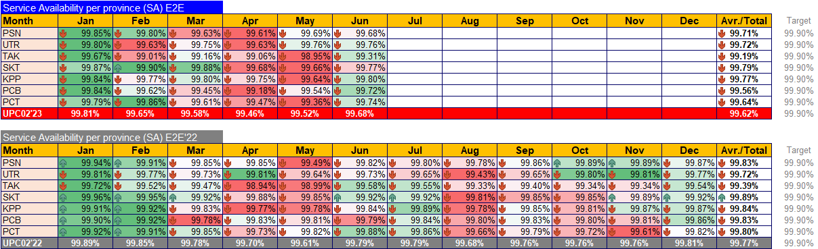
All Service availability compare by Province
Managed Service

Slide 9
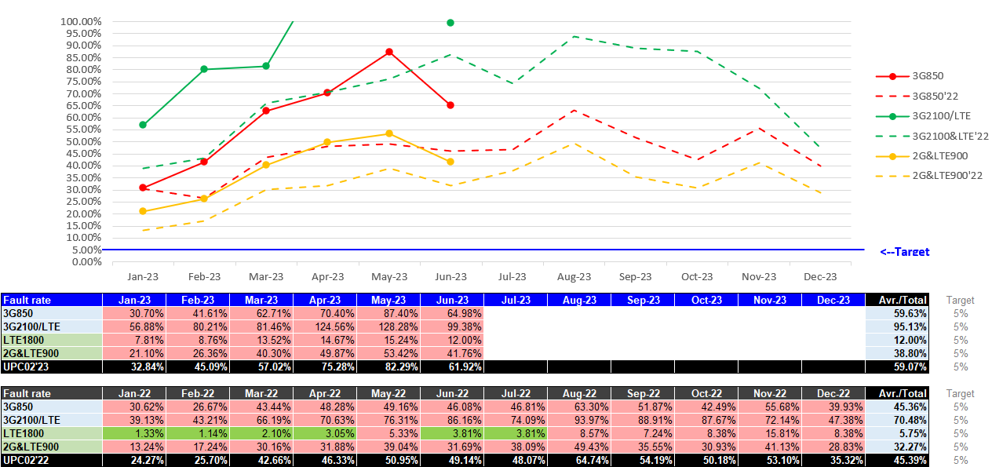
All Fault rate compare
Managed Service

Slide 10
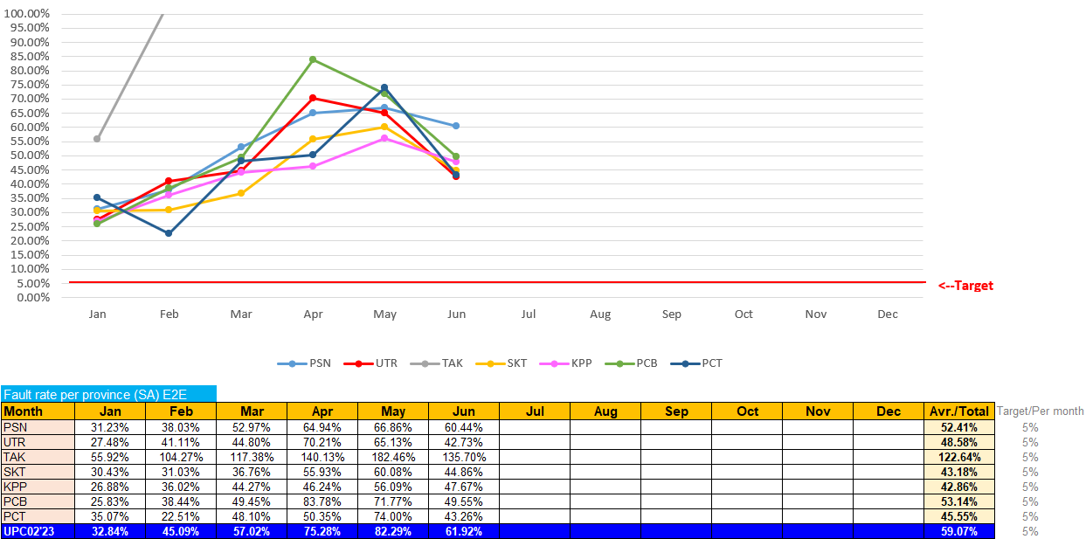
All Fault rate by Province
Managed Service

Slide 11
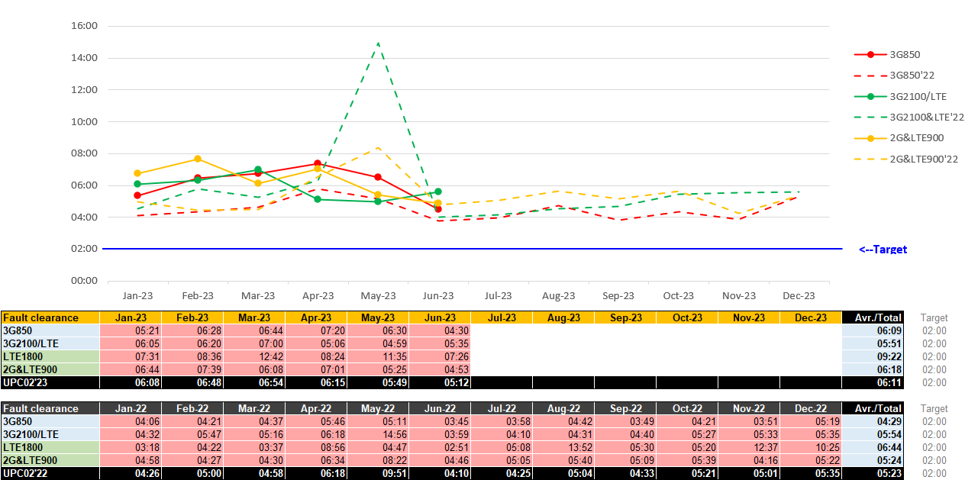
All Fault clearance compare
Managed Service

Slide 12
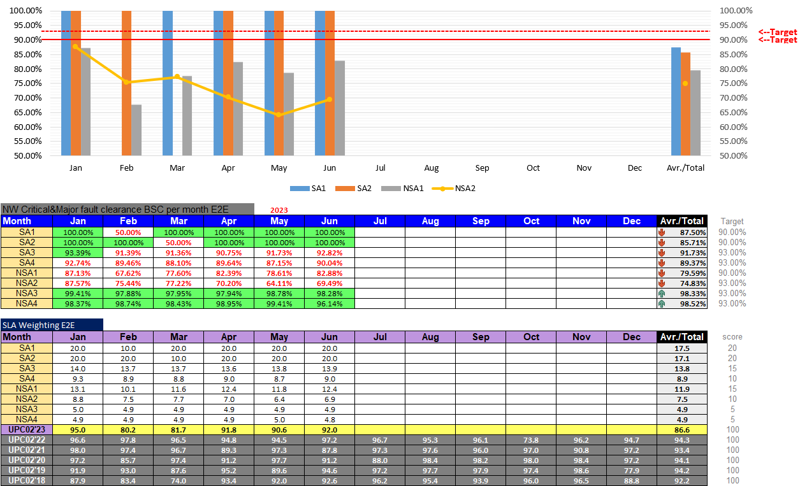
Major fault clearance BSC/SLA Weighting E2E
Managed Service

Slide 13
Network Performance All
- SA KEY Performance
- NSA KEY Performance
- Fault clearance time
- NW Availability & Fault rate
Managed Service

Slide 14
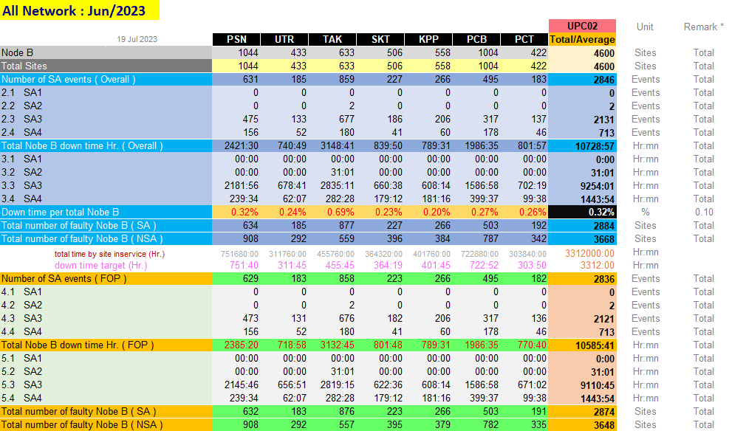
KPI Monthly Jun 2023
Ticket (All) SA KEY PERFORMANCE INDICATOR REPORT
Managed Service

Slide 15
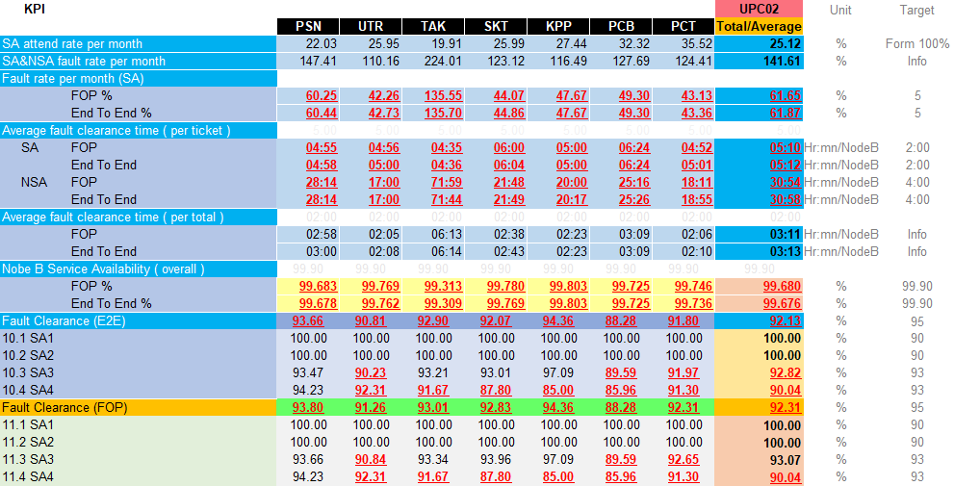
KPI Monthly Jun 2023
Ticket (All) SA KEY PERFORMANCE INDICATOR REPORT
Managed Service

Slide 16
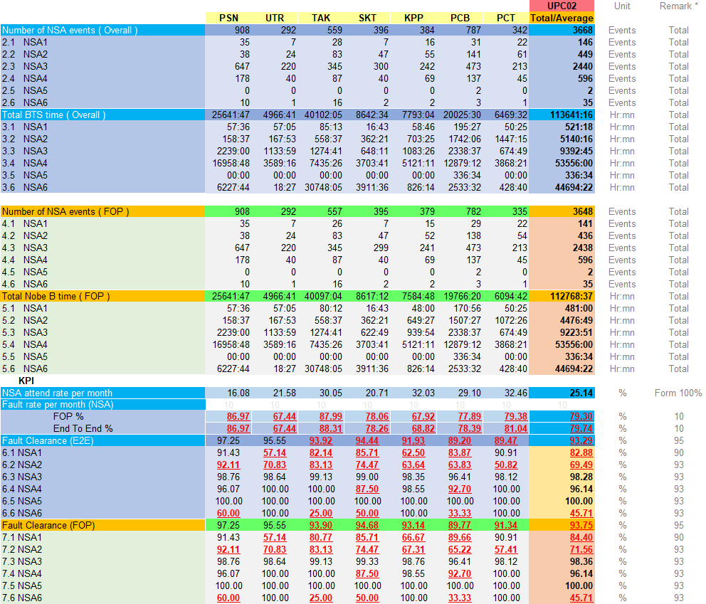
KPI Monthly Jun 2023
Ticket (All) NSA KEY PERFORMANCE INDICATOR REPORT
Managed Service

Slide 17
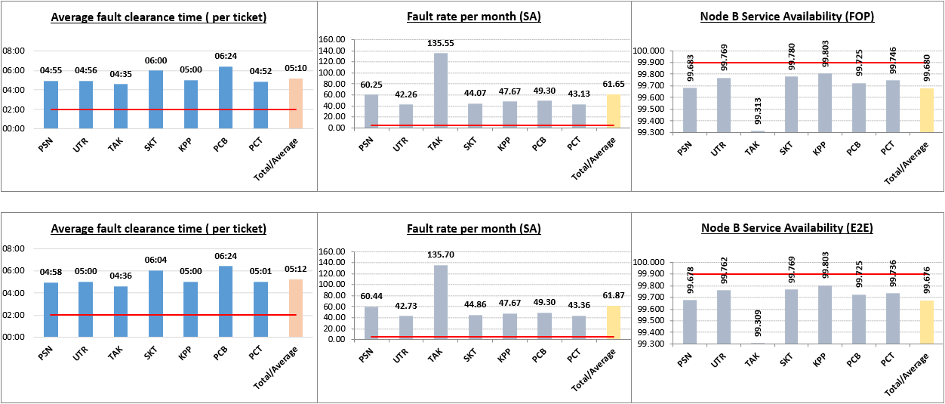
(All) Fault clearance time / Fault rate /NW Availability (E2E & FOP)
TaRget = 2:00 hr
TaRget = 5 %
TaRget = 99.90 %
FOP
End to End
Managed Service

Slide 18
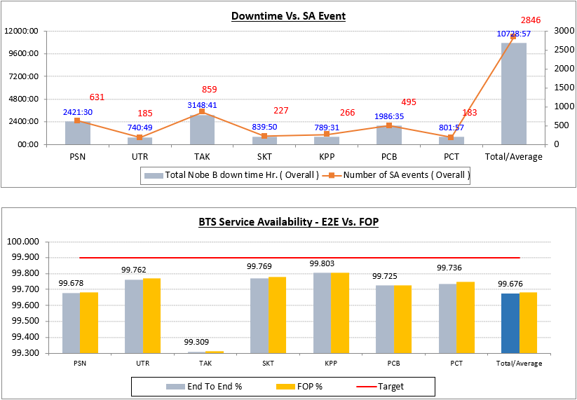
(All) Compare NW Availability & Down Time Ticket
2G900
TaRget = 99.90 %
Managed Service

Slide 19
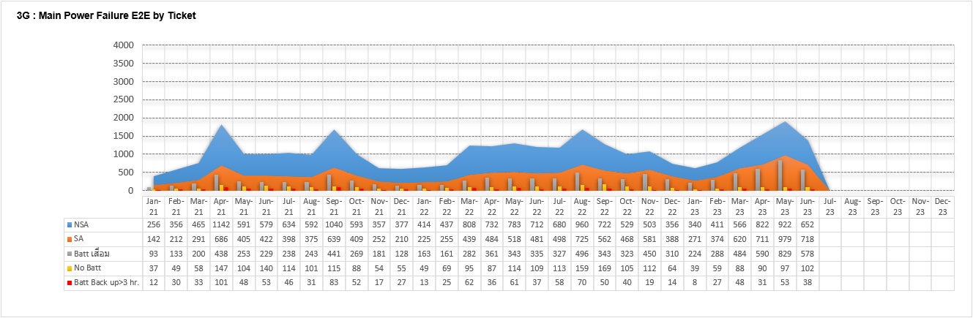
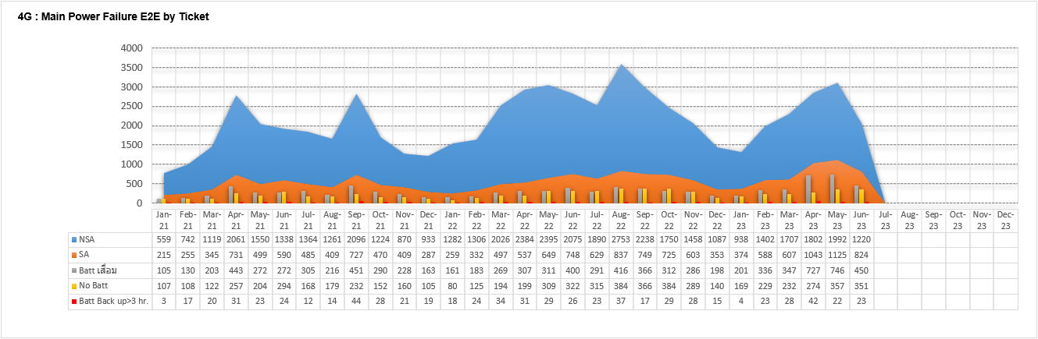
Trend Main Power failure in Year 2023
UPC01 2021
UPC01 2022
UPC01 2023
UPC01 2021
UPC01 2022
UPC01 2023
Managed Service

Slide 20
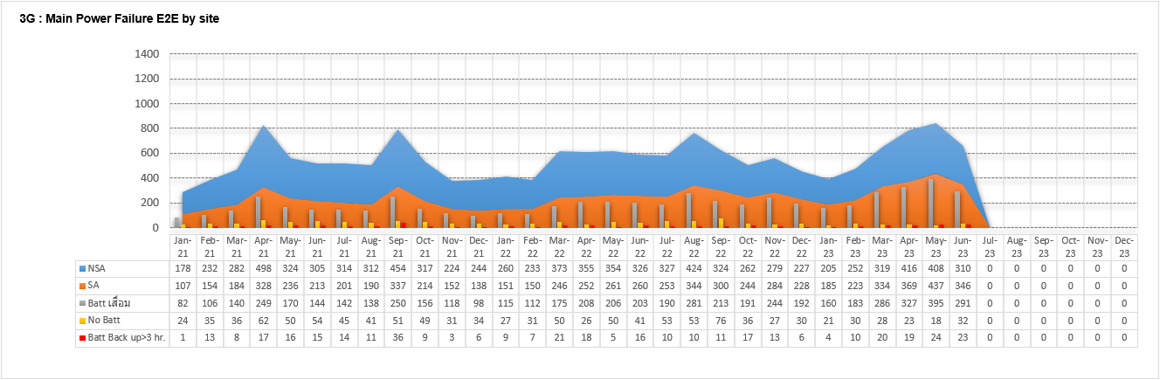
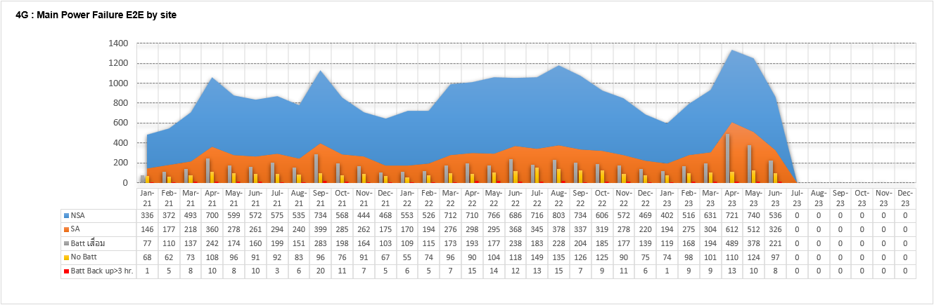
Trend Main Power failure in Year 2023 By Site
UPC01 2021
UPC01 2022
UPC01 2023
UPC01 2021
UPC01 2022
UPC01 2023
Managed Service

Slide 21
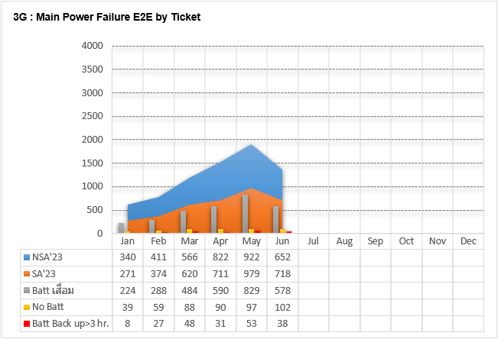
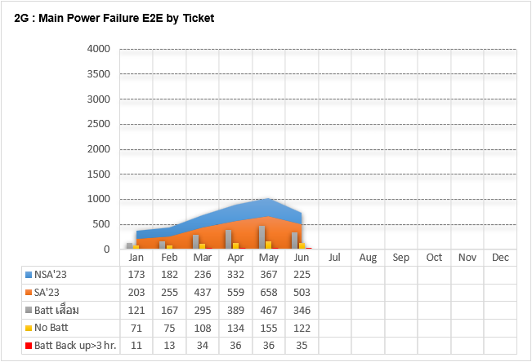
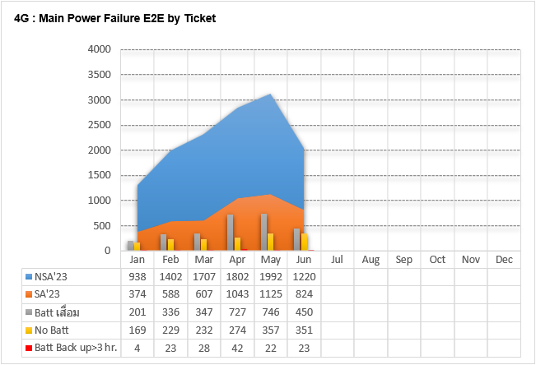
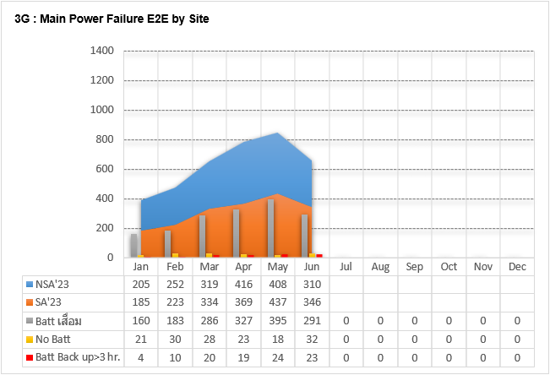
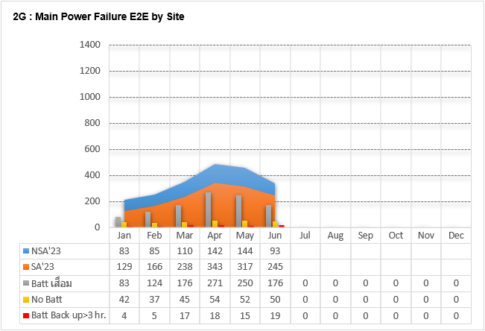
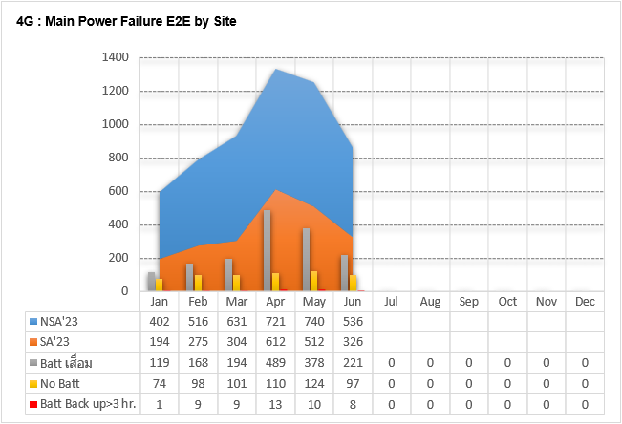
Trend Main Power failure in Year 2023 By Ticket & Site
Managed Service

Slide 22
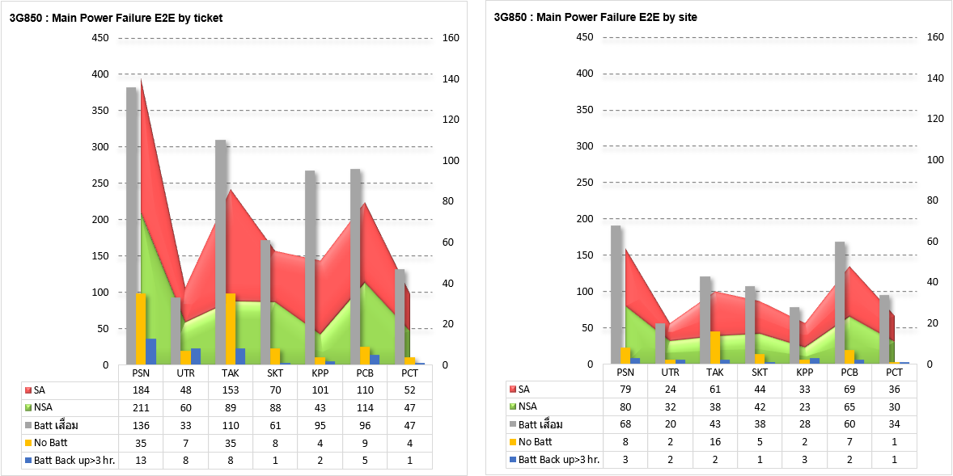
(3G850) Main Power Failure & Site Down By Ticket &Site
Managed Service

Slide 23
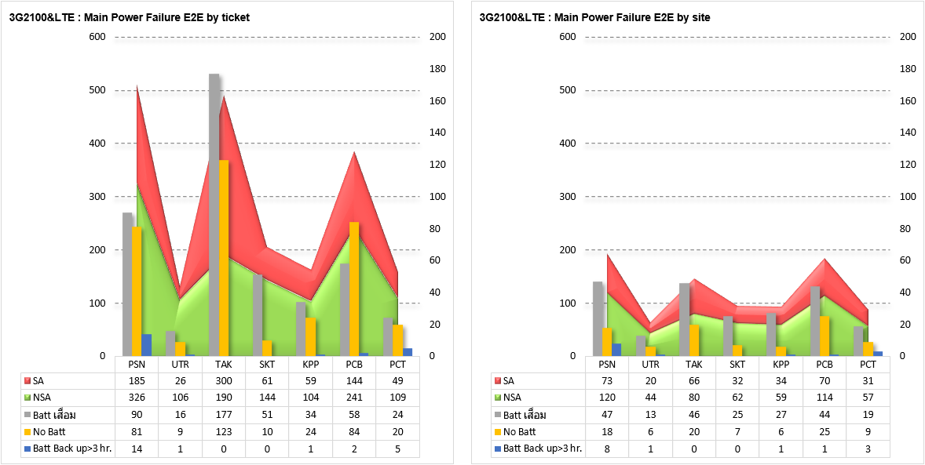
(3G2100&LTE) Main Power Failure & Site Down By Ticket &Site
Managed Service

Slide 24
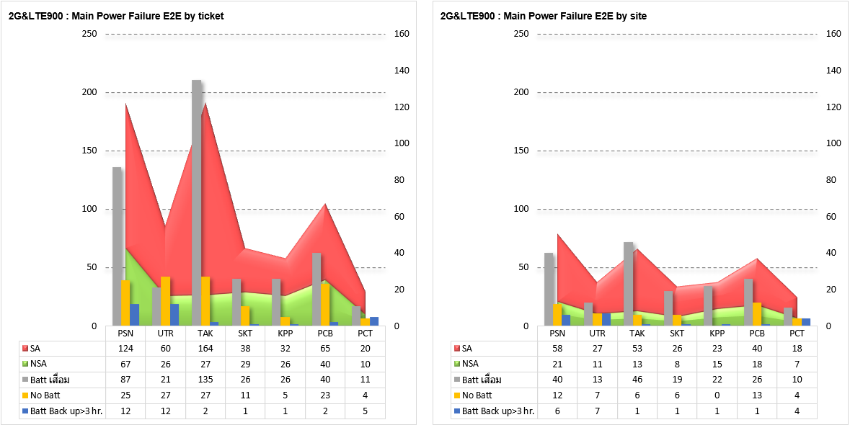
(2G+LTE900) Main Power Failure & Site Down By Ticket &Site
Managed Service

Slide 25
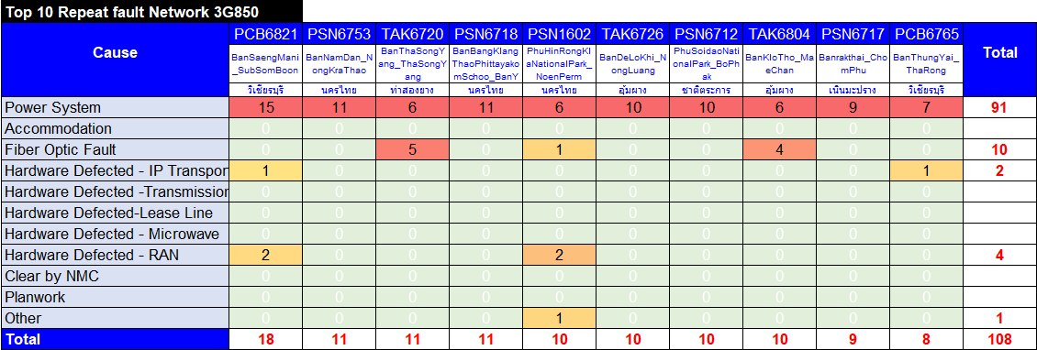
(3G850) Repeat Fault Apr 2023 (SA)
Repeat Fault all
Managed Service

Slide 26
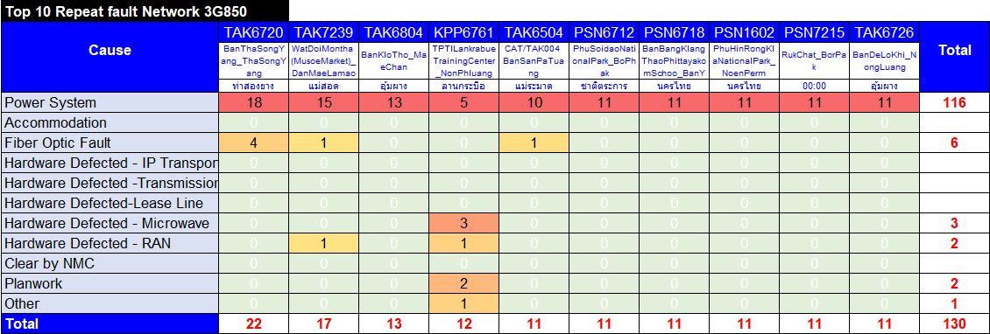
(3G850) Repeat Fault May 2023 (SA)
Repeat Fault all
Managed Service

Slide 27
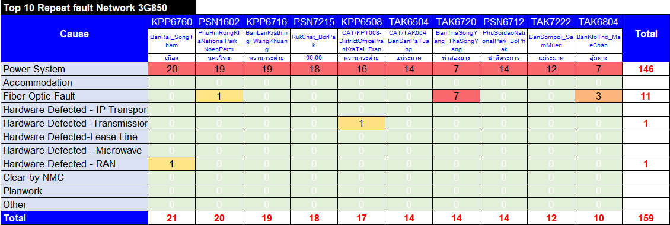
(3G850) Repeat Fault Jun 2023 (SA)
Repeat Fault all
Managed Service

Slide 28
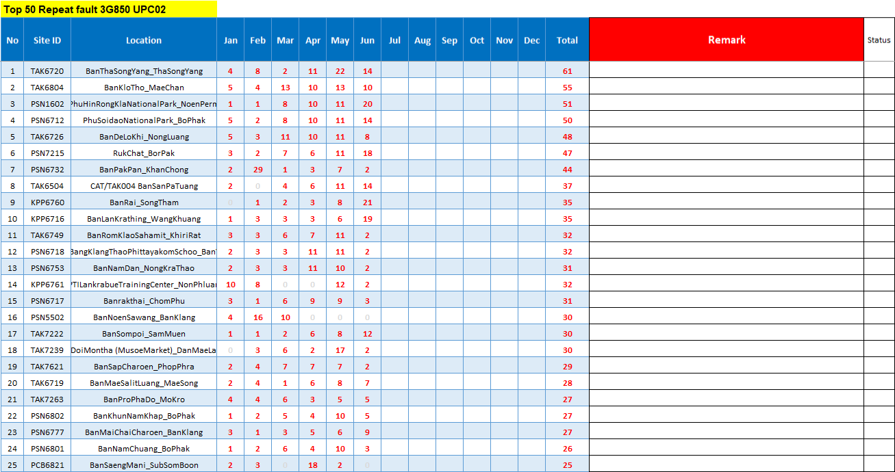
(3G850) Top 50 Repeat Fault by ticket Nor.2 (SA)
Managed Service

Slide 29
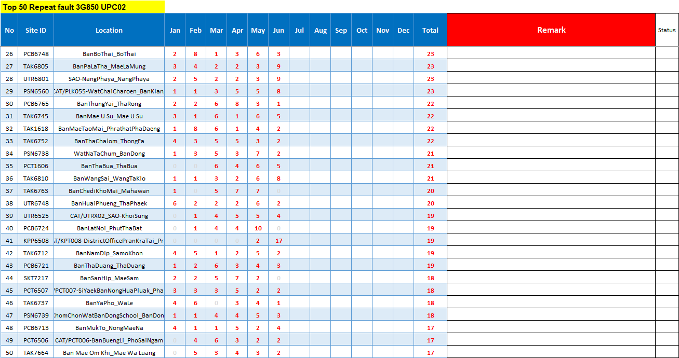
(3G850) Top 50 Repeat Fault by ticket Nor.2 (SA)
Managed Service

Slide 30
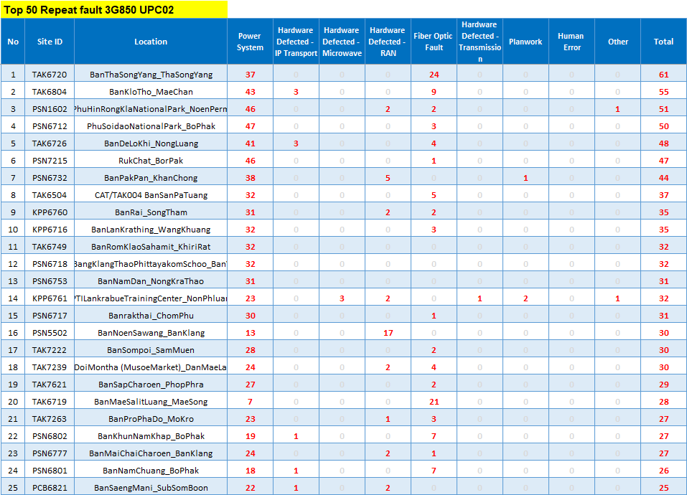
(3G850) Top 50 Repeat Fault by cause Nor.2 (SA)
Managed Service

Slide 31
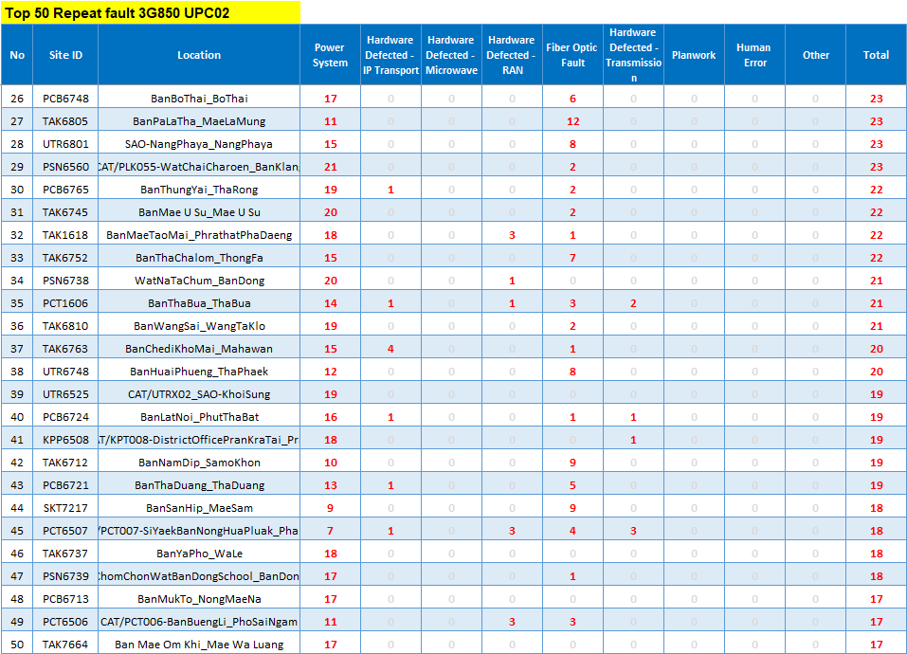
(3G850) Top 50 Repeat Fault by cause Nor.2 (SA)
Managed Service

Slide 32
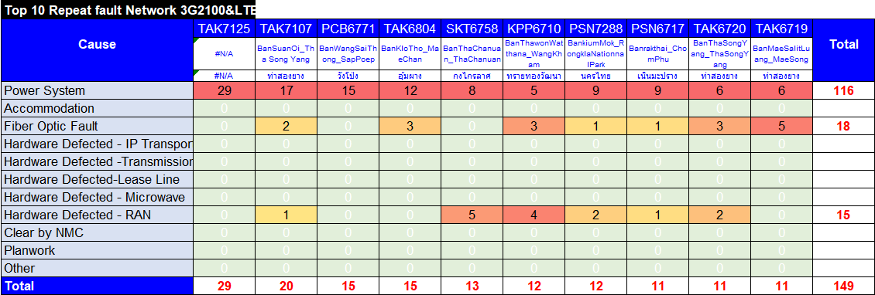
(3G2100&LTE) Repeat Fault Apr 2023 (SA)
Repeat Fault all
Managed Service

Slide 33
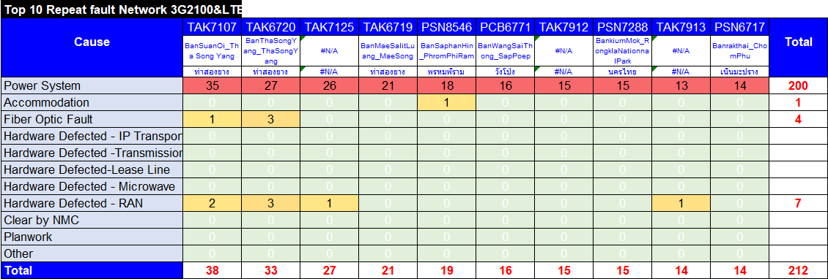
(3G2100&LTE) Repeat Fault May 2023 (SA)
Repeat Fault all
Managed Service

Slide 34
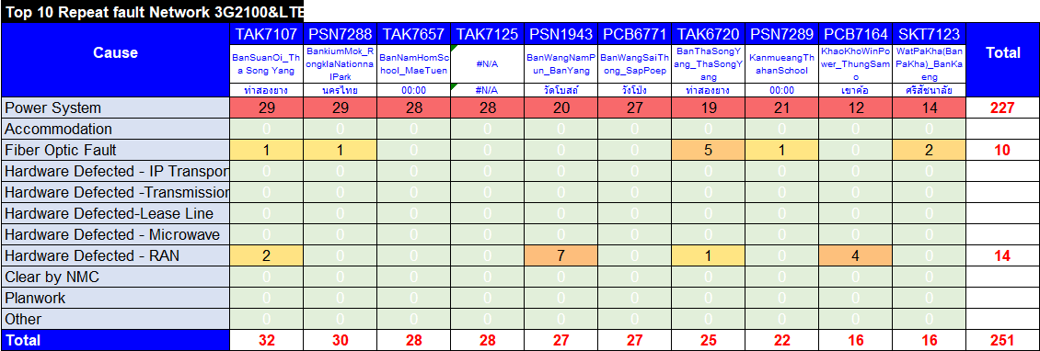
(3G2100&LTE) Repeat Fault Jun 2023 (SA)
Repeat Fault all
Managed Service

Slide 35
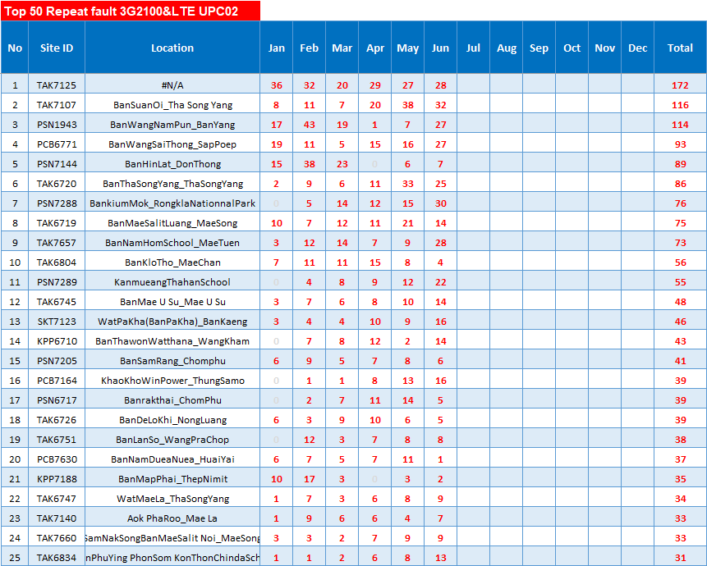
(3G2100&LTE) Top 50 Repeat Fault by ticket Nor.2 (SA)
Managed Service

Slide 36
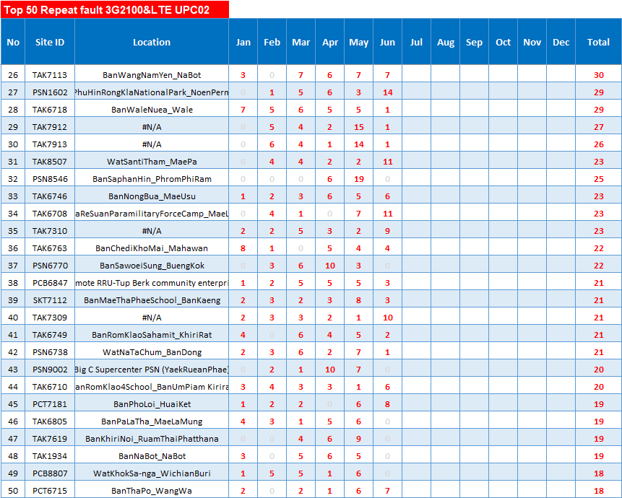
(3G2100&LTE) Top 50 Repeat Fault by ticket Nor.2 (SA)
Managed Service

Slide 37
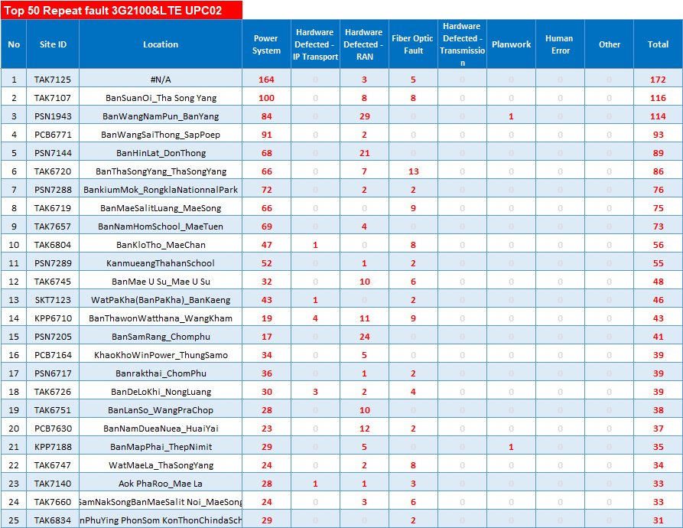
(3G2100&LTE) Top 50 Repeat Fault by cause Nor.2 (SA)
Managed Service

Slide 38
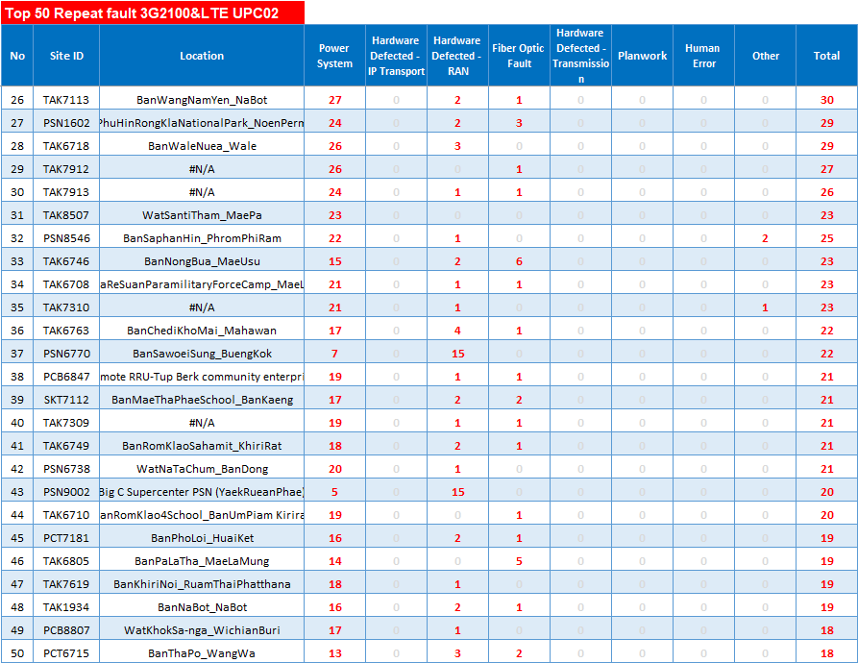
(3G2100&LTE) Top 50 Repeat Fault by cause Nor.2 (SA)
Managed Service

Slide 39
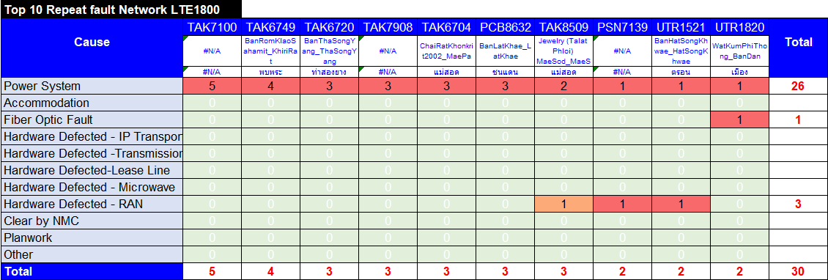
(2G+LTE900) Repeat Fault Apr 2023 (SA)
Repeat Fault all
Managed Service

Slide 40
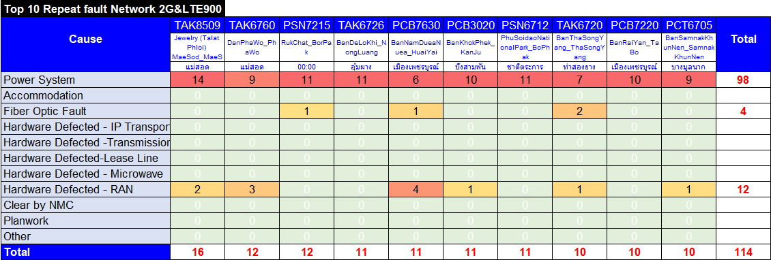
(2G+LTE900) Repeat Fault May 2023 (SA)
Repeat Fault all
Managed Service

Slide 41
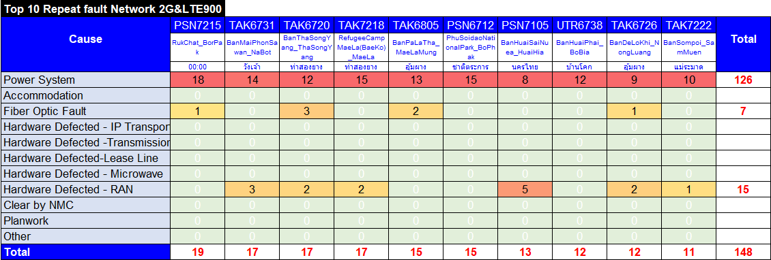
(2G+LTE900) Repeat Fault Jun 2023 (SA)
Repeat Fault all
Managed Service

Slide 42
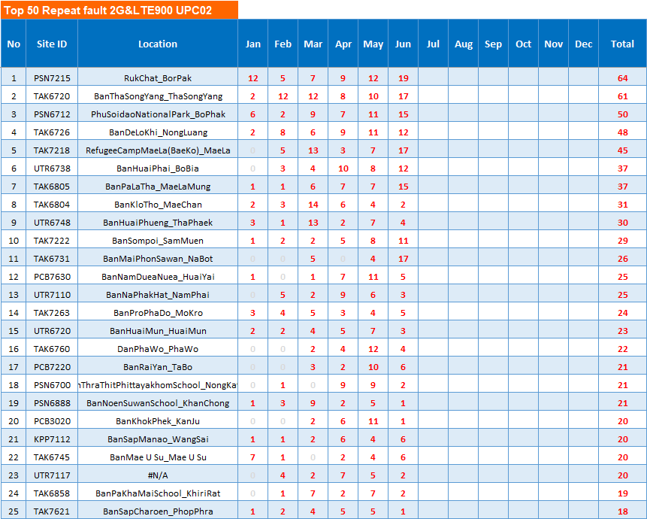
(2G+LTE900) Top 50 Repeat Fault by ticket Nor.2 (SA)
Managed Service

Slide 43
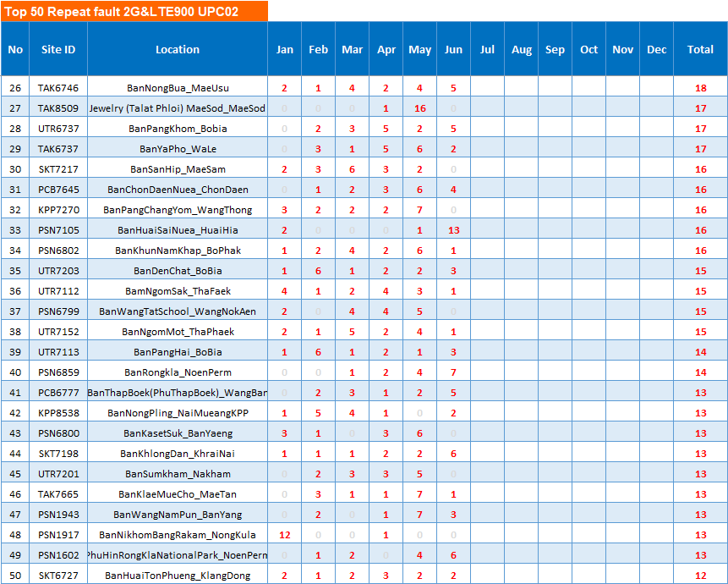
(2G+LTE900) Top 50 Repeat Fault by ticket Nor.2 (SA)
Managed Service

Slide 44
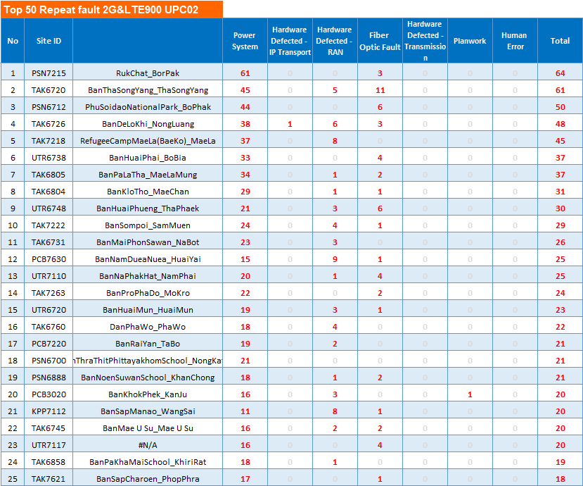
(2G+LTE900) Top 50 Repeat Fault by cause Nor.2 (SA)
Managed Service

Slide 45
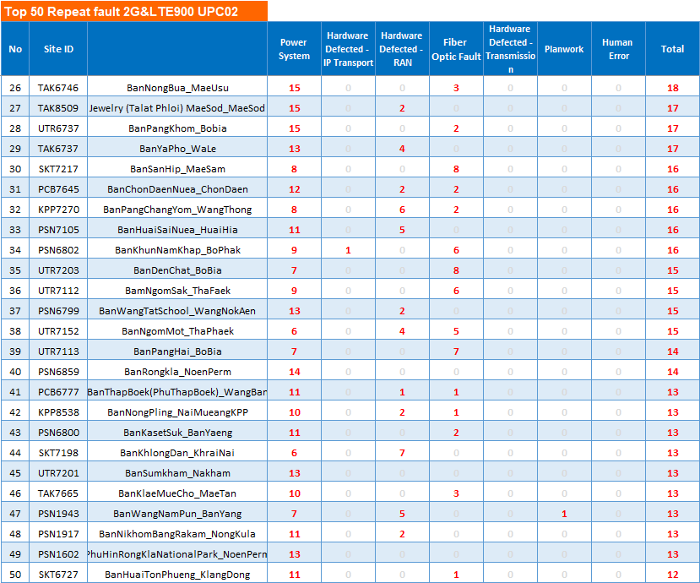
(2G+LTE900) Top 50 Repeat Fault by cause Nor.2 (SA)
Managed Service

Slide 46




Percentage ของ Cause Of Faultแยกตาม Downtime
Percentage ของ Cause Of Faultแยกตามจำนวน SA Ticket
(All) Cause of Fault (SA)
Managed Service

Slide 47




Percentage ของ Cause Of Faultแยกตาม Total time
Percentage ของ Cause Of Faultแยกตามจำนวน NSA Ticket
(All) Cause of Fault (NSA)
Managed Service

Slide 48


(3G850) Cause of Fault (SA) by Province
Managed Service

Slide 49


(3G850) Num vs. Fault rate Cause of Fault (SA) by Province
Managed Service

Slide 50


(3G2100&LTE) Cause of Fault (SA) by Province
Managed Service

Slide 51


(3G2100&LTE) Num vs. Fault rate Cause of Fault (SA) by Province
Managed Service

Slide 52


(2G+LTE900) Cause of Fault (SA) by Province
Managed Service

Slide 53


(2G+LTE900) Num vs. Fault rate Cause of Fault (SA) by Province
Managed Service

Slide 54


Ticket Over SLA Jun 2023
Managed Service

Slide 55

Ticket Over SLA Jun 2023
Managed Service

Slide 56


Ticket Over SLA Jan - Jun 2023
Managed Service

Slide 57


together
we can make
it
The End
Managed Service

